Slide 1
UI Airlines
Developing and deploying cloud based application
Ngui Tze Ken – TP031955
Notes:
Hi, my name is Tze Ken.
Today, I’ll be talking about developing and deploying a cloud based application with UI Airlines

Slide 2
Design
Notes:
Firstly, lets look at the design of the application

Slide 3
Design Considerations
Flight booking system
Expand into the US
Test a few routes in SEA
Budget of RM150 per month for development
Notes:
A few things to note before we begin:
Firstly, the application is a flight booking system,
It allows users to register new accounts, search for flights and book seats.
The company is looking to expand their reach into the US
As well as test a few routes in SEA,
The team is given RM150 per month in Azure credit and needs to work around that to produce a proof of concept

Slide 4
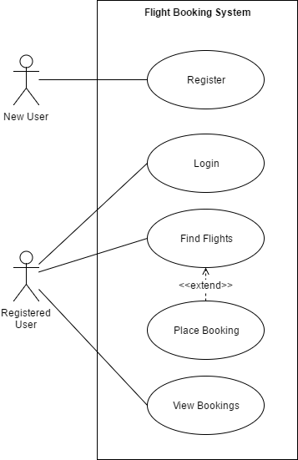
Use Case
Notes:
The use cases of each user are represented by the diagram here:
A new user can register for an account
And a registered user can login, view their bookings, find flights and place bookings.

Slide 5
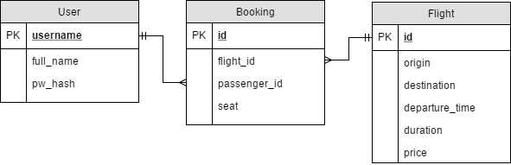
Data Model
Notes:
Based on the use case, an ERD for the database was created.
It contains three tables: user, booking and flight.

Slide 6
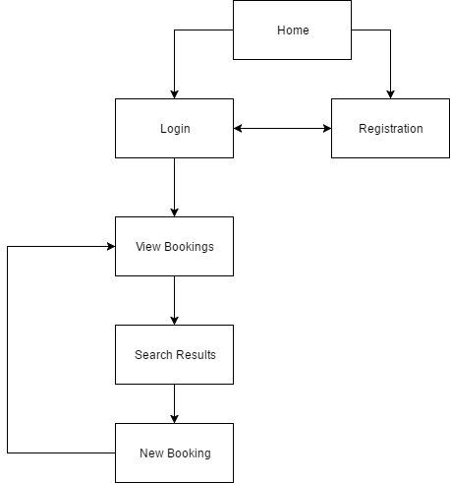
Sitemap
Notes:
Also created was the Sitemap
This shows the pages in the system and how the user goes through it.
All users begin at the Homepage and can either register for a new account or login to an existing one
Once logged in, they can view their bookings, search for flights and place new bookings.

Slide 7
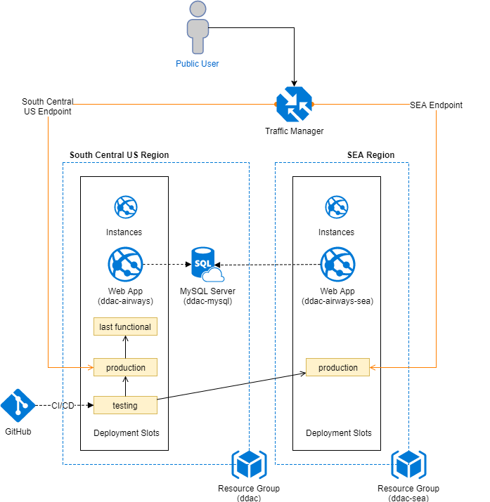
Cloud Architecture (Development)
Notes:
Next is the cloud architecture used for development. This is what was used to stay within the budget given.
As the main focus is in the US region, the main resources will be placed in the South Central US region
This includes the MySQL server and the deployment slots
The SEA region will only use a single deployment slot as the application will be deployed simultaneously to both regions after testing
Deployment is synced with GitHub so that all changes there are immediately pushed to the web app for continuous integration
A Traffic manager mediates all traffic so that users are served by the web app closest to their region.

Slide 8
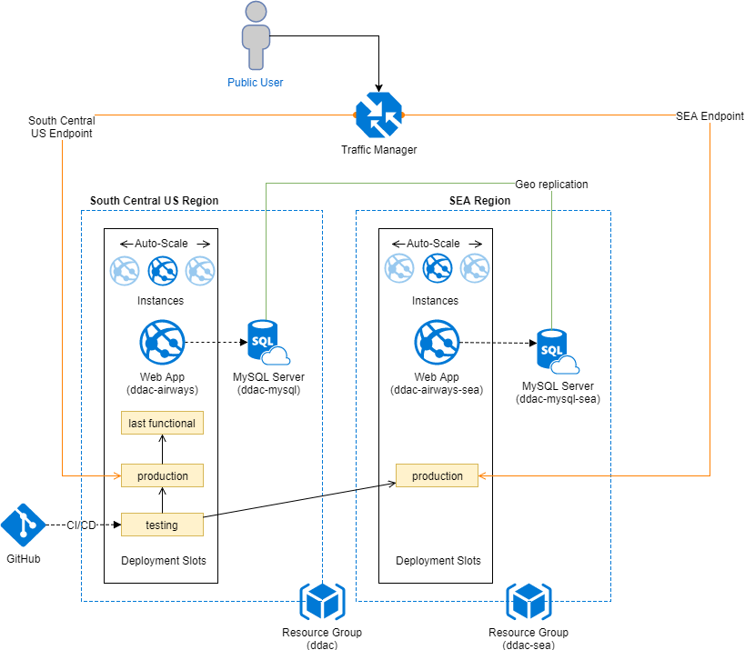
Cloud Architecture (Proposed)
Notes:
The architecture proposed for full release has a few changes added:
Firstly, there are now two databases in both regions that are geo replicated.
The instances are also now using a minimum of 3 and auto scaled.
Not shown here is also the fact that the South Central US app service will be using the S3 tier.

Slide 9
Cloud Architecture (Cost)
Service type | Region | Description | Estimated Cost
App Service | South Central US | 3 instance(s) x 744 Hours, Size: S3, Standard tier | RM3,972.96
App Service | Southeast Asia | 3 instance(s) x 744 Hours, Size: S1, Standard tier | RM993.24
Traffic Manager | Central US | 5 million DNS queries/mo, 2 Azure endpoint(s) | RM15.22
Azure Database for MySQL | South Central US | Standard: 400 Compute Units, 1 Servers, 125 GB Storage | RM1,289.89
Azure Database for MySQL | Southeast Asia | Standard: 100 Compute Units, 1 Servers, 125 GB Storage | RM477.42
 |  | Monthly Total | RM6,748.72
 |  | Annual Total | RM80,984.69
Notes:
When fully deployed, the proposed architecture will cost RM6748 per month
Most of it goes to the S3 app service

Slide 10
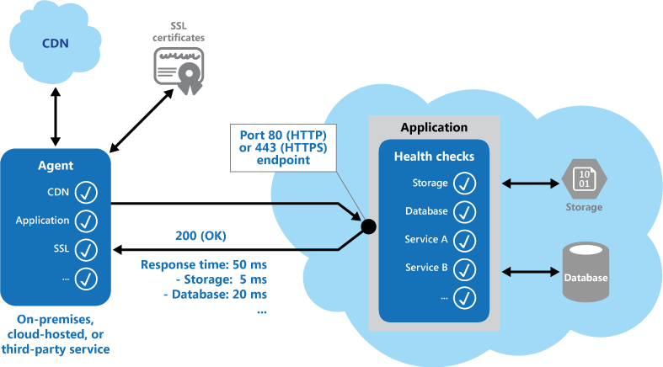
Design Patterns
Notes:
One of the design patterns employed in the application is the health endpoint monitoring pattern
This pattern exposes an endpoint in the application so that the status of its components may be monitored by an agent
In the UI airlines application, this pattern is used so the traffic manager can monitor an application’s health.
It allows the traffic manager to stop directing traffic to a web app instance if that instance is reporting any issues

Slide 11
Implementation
Notes:
Next, we’ll take a look at the implementation of the system

Slide 12
Languages
PHP
MySQL
JavaScript
CSS
HTML5
Apache/IIS Routing
Notes:
The languages used include
PHP, MySQL, JavaScript, CSS, HTML5 as well as routing languages for apache and Microsoft IIS
The lattermost is used only for rewriting the URL for the application page manager

Slide 13
Libraries
Semantic UI
AnyChart.com
Generatedata.com
XAMPP
Notes:
There were two third-party libraries used in the development of this application:
Semantic UI – A HTML5/JavaScript framework that provides web UI elements and functionality,
Anychart.com which provides interactive charts via SVG images which is used for the airplane seat picker,
Generatedata.com which is used to generate flight data for the database.
XAMPP is a local apache, PHP, MySQL server which was used for the development of the system offline.
Details on the implementation of the system can be found in the documentation.

Slide 14
Publishing
Notes:
With a working application, the next step was to publish it to Azure.
For this part, we’ll take a look at the Azure portal

Slide 15
Publishing
Web App
Deployment Options (Github)
Deployment slots
MySQL Server
Traffic Manager
Notes:
Firstly, a web app service was provisioned.
This is the main one, placed in the South Central US region
Under the deployment options, it is linked with GitHub so that any changes pushed to the repository are synced to the web server
One thing to note is that during development, an apache server was used so the htaccess rewrite rules worked there
However, on Azure, because an IIS server is used instead, the rewrite rules needed to be translated into a web.config format.
Over here you can see the deployment slots provisioned for the application as well.
Under application scaling,
The web app uses the S1 tier because of the RM150 constraint and because it is the minimum level at which a traffic manager and deployment slots are supported.
Under scaling out,
An autoscale setting is used based on CPU utilization. An instance is added when it goes above 80% and removed when it drops below 40%
Also, an extension was added to force the use of SSL on the web application.
The second web app is provisioned the same way, but in the SEA region and without any deployment slots configured.
With the web app provisioned, the next step was the database.
A MySQL database was chosen since the application was written to work with MySQL.
This is also located in the south central US region.
The Azure MySQL database service provides the same features as the SQL Server service.
This includes monitoring, and security. For development however, the firewall has been set to allow all IPs.
Finally, the traffic manager was set up. The endpoints for both web apps were added
and the endpoint monitoring path was added as well.
For demonstration, the health endpoint for the South Central US is returning a poor health status to show it is working.
The traffic manager is configured to geographic with the SEA endpoint serving only Asia and Australia/pacific regions
While all other traffic is directed to the South Central US endpoint

Slide 16
Testing
Notes:
Moving on to testing, the unit tests for the application were done using the test plan
Available in the documentation.
As for the performance tests, they are done through the Azure web portal.

Slide 17
Testing
Performance Tests
Record Response Time & Errors
Test in 200 user increments
From 200 to 800 users
Service plans S1, S2 and S3
Notes:
The tests will be conducted on the main web app service and will test a user load of 200 to 800
for two minutes with each test increasing in user load by 200 user increments.
The results that will be gathered include response time and failed requests.
These tests will be conducted on three app service plans – S1, S2 and S3.

Slide 18
Results
Concurrent Users App Service Plan | 200 | 400 | 600 | 800
S1 | 0.59 Sec 0 Failed | 1.74 Sec 0 Failed | 6.75 Sec 1 Failed | 10.83 Sec 309 Failed
S2 | 0.25 Sec 0 Failed | 1.42 Sec 0 Failed | 3.63 Sec 2 Failed | 8.09 Sec 251 Failed
S3 | 0.27 Sec 0 Failed | 10.6 Sec 0 Failed | 3.93 Sec 0 Failed | 7.18 Sec 215 Failed
Notes:
And here are the results of the test.
Apart from the little inconsistency at 600 users
Where S2 performed better than S3, the results are consistent with what is expected.
S3 is better than S2 which is in turn better than S1.
However, there is a much bigger improvement from S1 to S2 than there is from S2 to S3.

Slide 19
Analysis
S1 can handle 400 concurrent users
S2 and S3 can handle 600 concurrent users
Improvement from S1 to S2 is higher than S2 to S3
S2 provides the best performance for the price
Notes:
A few conclusions can be made from the analysis
As the maximum threshold for page load times is 4 seconds,
S1 can reliably handle 400 users whilst S2 and S3 can handle 600
As mentioned before, the improvement between S1 and S2 is much higher than S2 to S3
This makes S2 the best performance value at roughly RM662.12 per month

Slide 20
System Demo
Notes:
Finally, lets take a look at the system in action

Slide 21
Demo
Notes:
Firstly, this is the homepage, users can either login or signup.
The start flying button also takes the user to the signup page.
All forms in the application are validated with JavaScript before submitting.
Once a user signs up, they are logged into their account immediately.
This is the member home page. It shows the flights that the user has booked.
To make it easier for the user, a search panel is located on the right.
They can search by origin, destination or both.
Once the search is performed, they can select a flight and they will be taken to the booking page.
Here, they are shown the flight details and can choose a seat.
Occupied seats such as 1-F will not be selectable.
Once they have placed a booking, they will be taken back to their homepage and the booking will now be visible there.

Slide 22
Source
GitHub [https://github.com/Isaacntk/ddac-airline]
Notes:
That concludes my presentation on the application.
The source code for it is available at this link.
Thank you.

